Slide 1


Improving revenue through engagement
Unprecedented ARPU analysis
Predictive engagement metric
Tangible business outcome
Stewart Kennedy. - Scotland
Oliver Stula - Germany
Ayodeji Jolaoso - The Netherlands
Xavier Carbonez - Belgium
batch #1708

Slide 2

Business model Brazaar
E-commerce platform
Commission
Commission
SELLER 1
SELLER 2
R$
R$
R$
R$
CUSTOMER 1
CUSTOMER 2
CUSTOMER 3
CUSTOMER 1

Slide 3
Business model Brazaar
603R$ arpu per year
=> flat evolution
=> 3000 sellers, high churn
E-commerce platform
13%
120R$ per order
Commission
Commission
SELLER 1
SELLER 2
40
orders
per seller
R$
R$
R$
R$
CUSTOMER 1
CUSTOMER 2
CUSTOMER 3
CUSTOMER 1

Slide 4
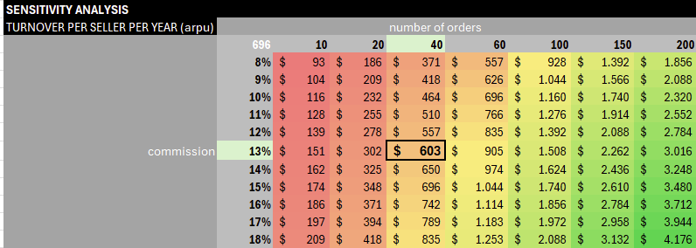

Increase ARPU for Brazaar
A sensitivity analysis serves to visualize the impact on a KPI when underlying parameters evolve

Slide 5
Increase ARPU for Brazaar
BENCHMARKS
PAID SERVICES

Slide 6

Datasets
Internal data
e-com platform
(kaggle)
External data
° seller margins
° platform commissions
Engagement scoring
RFM-model

Slide 7
R
F
M
Recency
avg days between orders
Frequency
amount of orders
Monetization
total value
+
+
=
Engagement (%)
13 days
(7/10)
+
9 orders
(8/10)
+
878 $
(9/10)
=
80%
(24/30)
RFM is a proven model in e-commerce which we tuned into an engagement score for every single ID

Slide 8
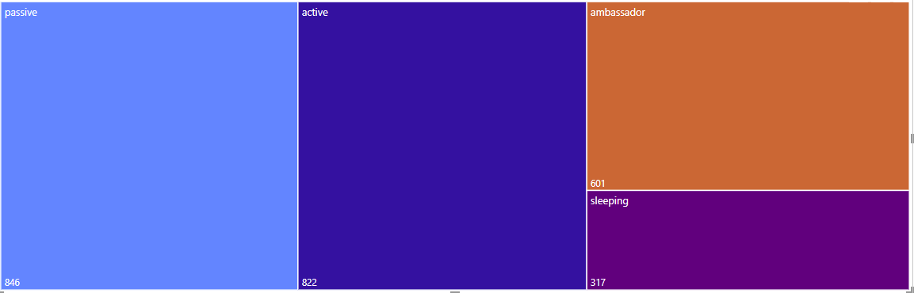
Segments - sellers
between 0-20 “sleeping”
between 20-40 “passive”
between 40- 60 “active”
between 60-100 “ambassador”

Slide 9
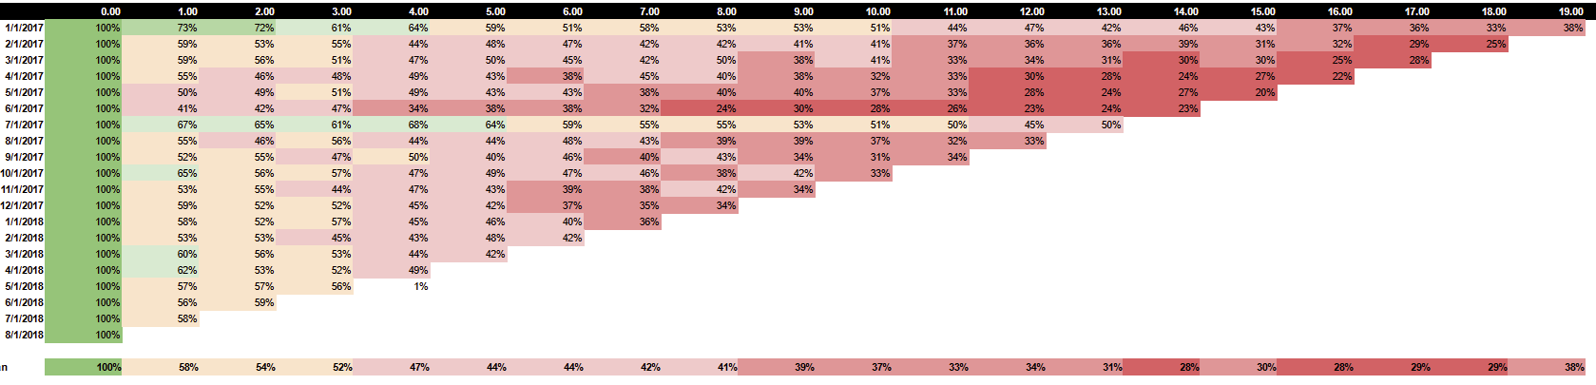

Cohort - sellers
After 2 months, only 50% of the sellers remains active?
After 1 year, only 33% is still active?
A method of studying groups of individuals within a defined period, to analyse and compare their behaviours (like churn) over time.

Slide 10
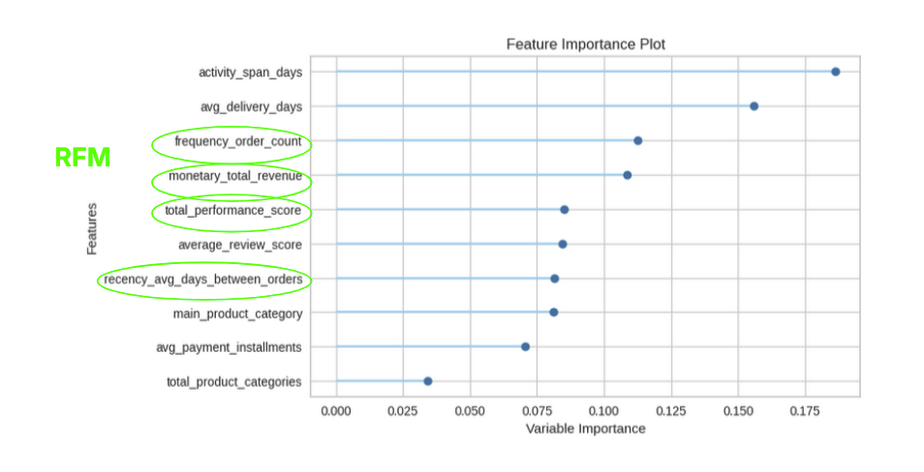
Correlations from sellers with their churn
Logistic regression:
Focused on recall over accuracy to reduce false negatives.
Emphasis on recall ensures detecting as many churners as possible at the expense of some false positives.

Slide 11
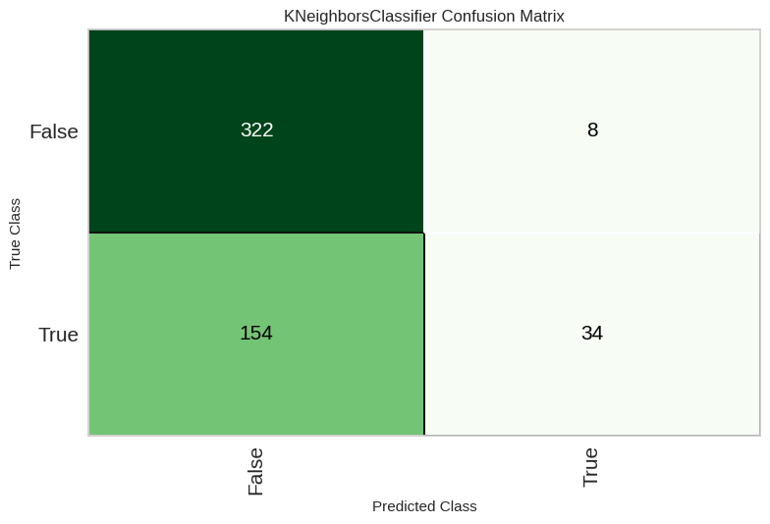
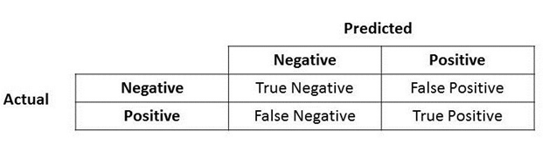

Predict churn
Recall: we want to detect all churners, even if we would falsely label an active seller as churner
=reduce false negatives
Accuracy 82%. The proportion of total predictions (both positive and negative) that the model got correct
Recall : 98.5%. The model identified a high percentage of positive cases correctly.

Slide 12
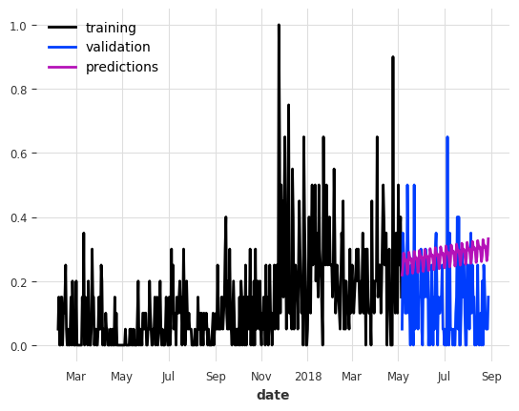
Sales-predictions per seller
Prophet model

Slide 13
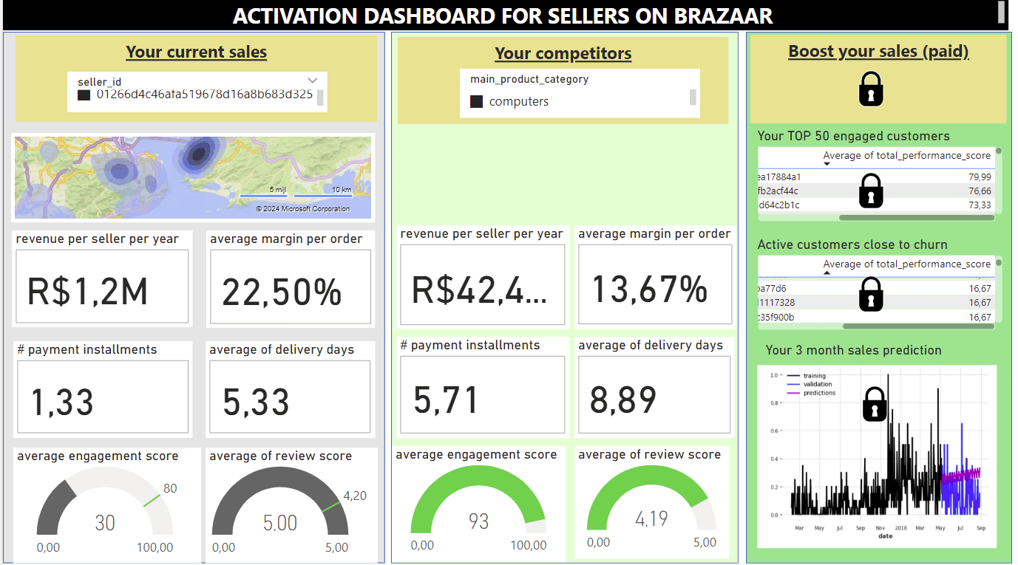

Slide 14

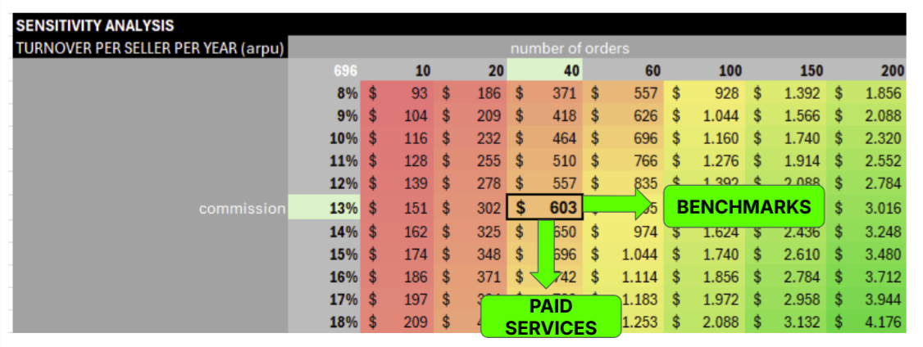

“Dashboard as a Product “ (DaaP)
“Boost your sales”
Learn from the best
Learn from your own data
Extra paying service for Brazaar-sellers
Pricing : 1% extra commission on sales
1% extra commission
=
7%
extra ARPU

